Slide 1
The best branch Locations in Toronto Neighborhoods
By Abdelaziz lila

Slide 2
Project Objectives
Determination of the best bank branch location in Toronto neighborhoods Depending on our distinctive approaches:
- Building demographics datasets for prospected clients Data Analysis
- Building a Decision making Model to predict the best locations for new branches in Toronto neighborhoods by Machine Learning.
-Mapping customers , competitors segmentation & clustering in neighborhoods by using Foursquare API

Slide 3
Why this project is important for a bank
Bank branches perform well when aligned with retail centers visited at similar frequency to bank visits on that way you are convenient to your customer’s existing shopping patterns and not a stand-alone destination
Locations lack significant retail focal point underperforms due to lack of convenience and draw impacting sales by as much as 20-30% .
Data will be plotted in a map and we will be able to describe the advantages and disadvantage for each particular location and to determine the feasibility of our expansion plan or transformation plan.
Consist Locational profiles of the existing customer base in the area under consideration determine the likelihood of financial success of branch and equipment under various scenarios.

Slide 4
Project Model
Define the objectives
Identify and weight the criteria
Demographics Data Analysis
Profile the best Nominated Neighborhoods
Implementing Foursquare API on Nominations
Mapping The best two nominations
Building and evaluating the best classification model by machine Learning
High,medium,low
Highest prospected clients
Neighborhood
Total population
Households
education
Employment
Best classifier
Location Data
Best Location
Waterfront Communities-The Island

Slide 5
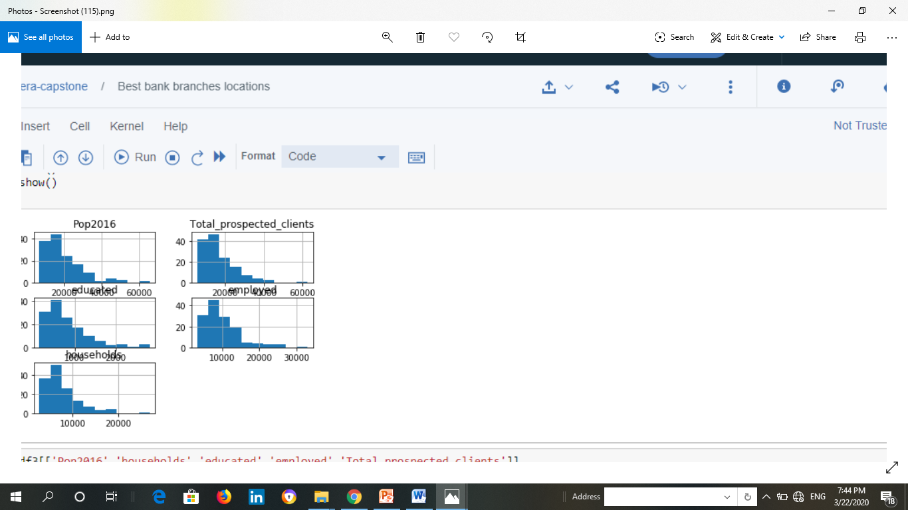
Data Analysis
All continuous variables have positive relationships and significance correlation except income level has a weak one and not seem a good predictor .
Data Categorized by Binning as high ,medium, low for classification models assessment

Slide 6
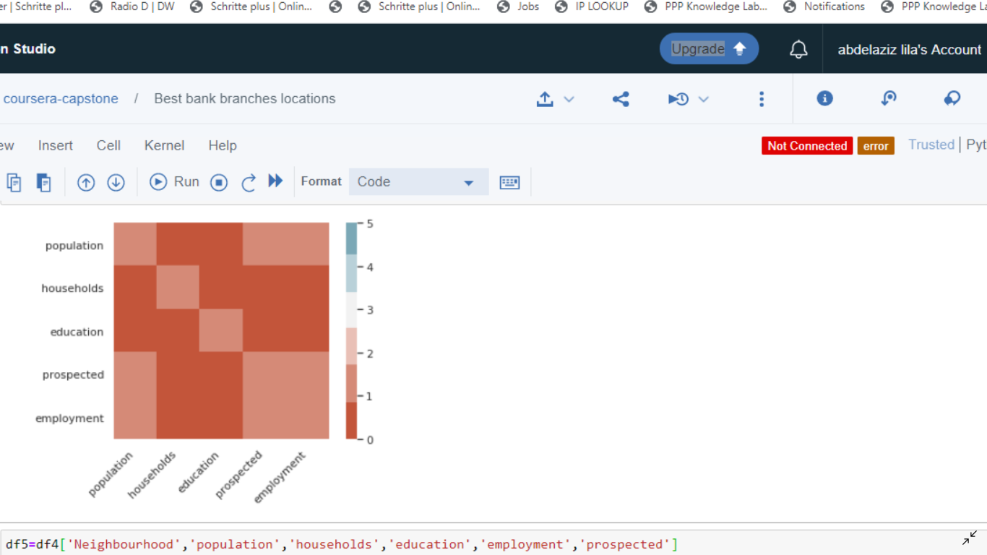
Heat Map&ANOVA
ANOVA analysis of variance shows a great result with large F- score showing strong correlation and a P-value less than 0.05 imply statistical significance.
Heat map shows the main variables that have the most important impact on total prospected clients number.
ANOVA | sum_sq | df | F | PR>(F)
C(treatments) | 3.103437e+10 | 4 | 176.65211 | 2.415009e-104
Residual | 3.052452e+10 | 695 | NAN | NAN

Slide 7
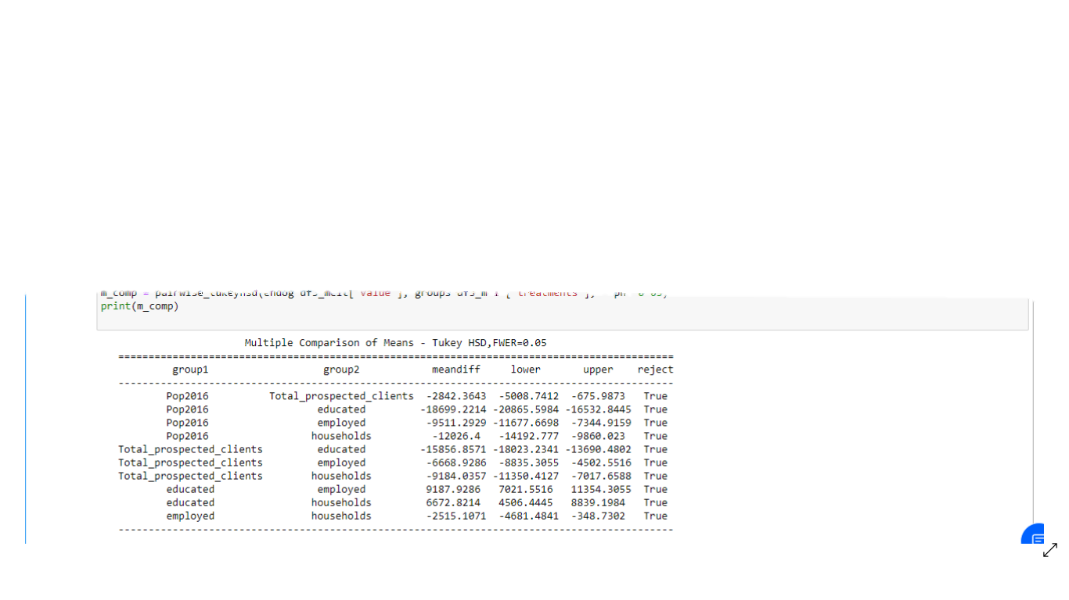
Validity Test
Tukey HSD Test
Above results from Tukey HSD suggests that , all pairwise comparisons for treatments rejects null hypothesis and indicates statistical significant differences.

Slide 8
Test ANOVA assumptions
The Shapiro-Wilk test :
can be used to check the normal distribution of residuals Null hypothesis: data is drawn from normal distribution. As the P-value less than 0.05 imply significant, we succeeded to reject null hypothesis and conclude that data is drawn from normal distribution
Bartlett’s test:
As the data is drawn from normal distribution, use Bartlett’s test to check the Homogeneity of variances. As the P-value less than 0.05 imply significant, we succeeded to reject null hypothesis and variance between variables is not equal .
Validity end result:
Model assumption is valid there is a strong relation between dependent and independents variables as demographics variables increase the expectation of increase in prospected clients is certain

Slide 9
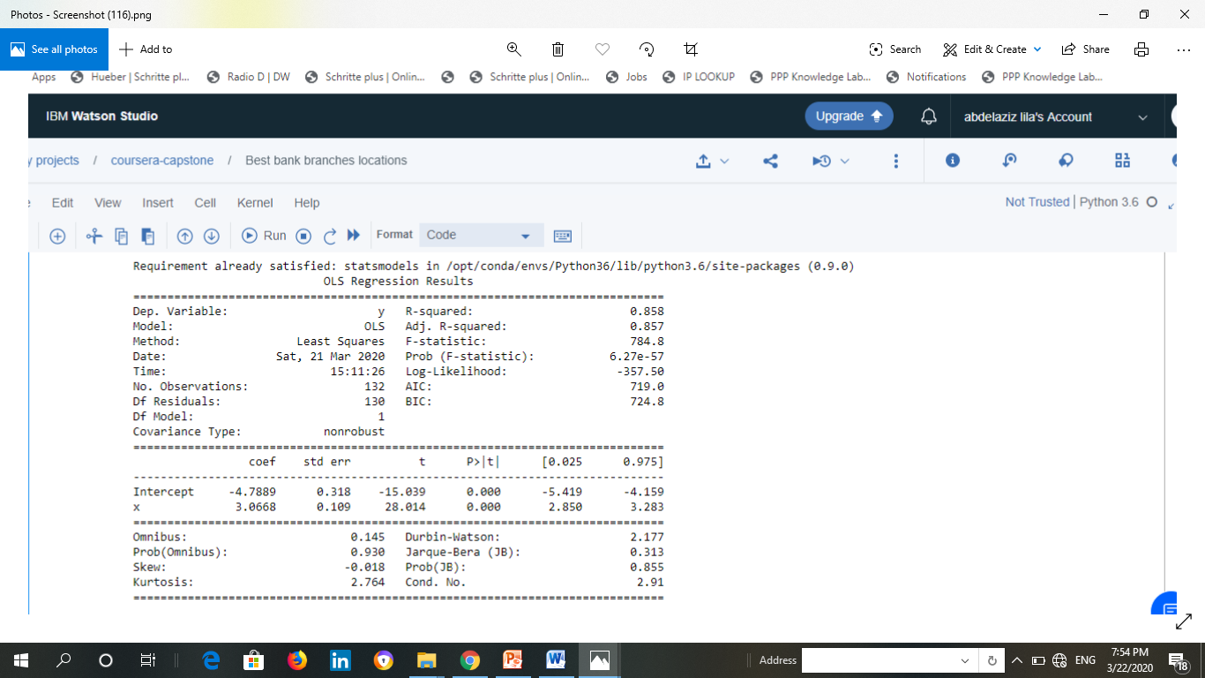
regression analysis
Ordinary Least Squares (OLS) Linear Regression

Slide 10
OLS regression analysis findings
Ordinary Least Squares (OLS) Linear Regression analysis is the best fit for Data modeling shows R2=0.858 imply good accuracy to predict values.
Prob(F-statistic)per the above results, probability is close to zero. This implies that overall the regressions is meaningful.
P –values is close to zero we could reject the null hypotheses and all variables are reliable.

Slide 11
The Best Classification Model
Evaluation | K-Means K=3 | SVM | Decision Tree | Logistic regression
Jaccard-similarity-score | 0.952 | 0.976 | 0.976 | 0.905
F1 | 0.976 | 0.975 | 0.975 | 0.830
Log Loss | N/A | N/A | N/A | 0.858
Despite of the best results for the first three models we will use the Logistic regression model as our variables are categorized and Logistic regression can also help us understand the contributing factors behind the prediction, and is not just a black box method Logistic regression is recommended in cases for Predicting the Customer Churn.

Slide 12
Nominated Neighborhoods
Willowdale East
Expected clients Population
43710
No competitive banks in the region
A region for entertainment
Place in a main square
Easy to reach the branch by bus
No retails venues concentration
Waterfront Communities-The Island
Expected Clients population
62585
Retails Venues Concentration
Competitive Bank branch exists
Place near shopping areas

Slide 13
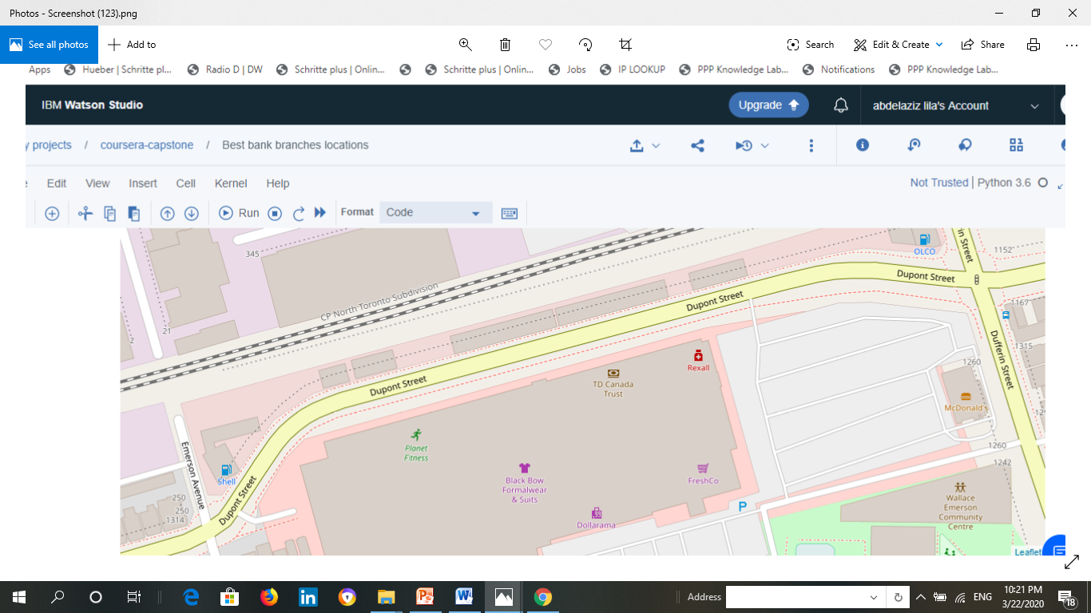
Foursquare API & Final Decision
Waterfront-communities
Upon Foursquare API analysis and data analysis the highest venues concentration which means more purchasing pattern and customers churn for our retails branch is found in Neighborhood waterfront-communities-The island which will support our final decision as the best locations for new branch.

Slide 14
THANK YOU FOR WATCHING

